Slide 1


May 2023
DATA WAREHOUSE PROJECT
@VKU

Slide 2
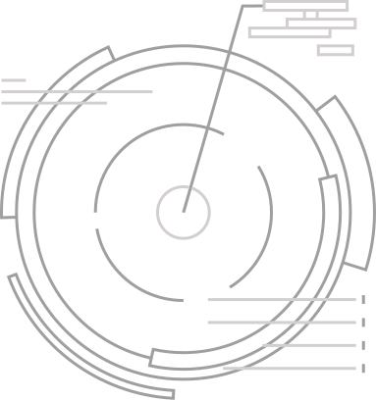


Member :
Phùng Anh Sang
Trương Bá Vương
Nguyễn Mạnh Trường Đạt
Nguyễn Thái Khánh Duy

Slide 3
Content :
Design Logical
Data Mining
SSIS Process
SSAS Process
SSRS Process

Slide 4



Design Logical

Slide 5
Design Logical
The process of creating a logical model or logical structure to organize and store data in a data warehouse system
Requirement Analysis
Conceptual Design: conceptual model that represents the entities, their attributes, and relationships within the system.
Logical Design: translate the conceptual model into a logical model that represents the structure of the data

Slide 6
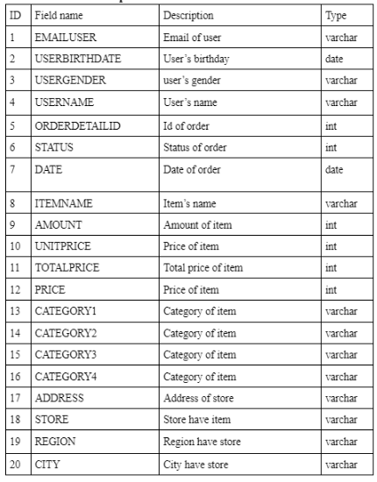
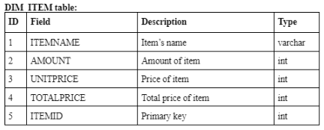
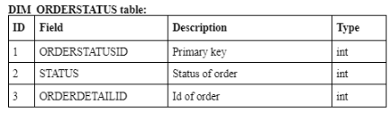
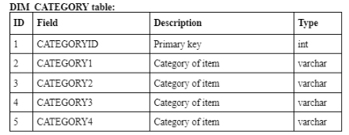
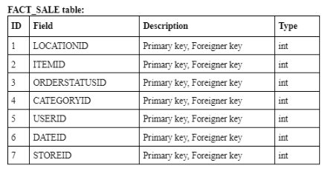
Design Logical
Analysis requirement (data)
Dimensions and Facts

Slide 7
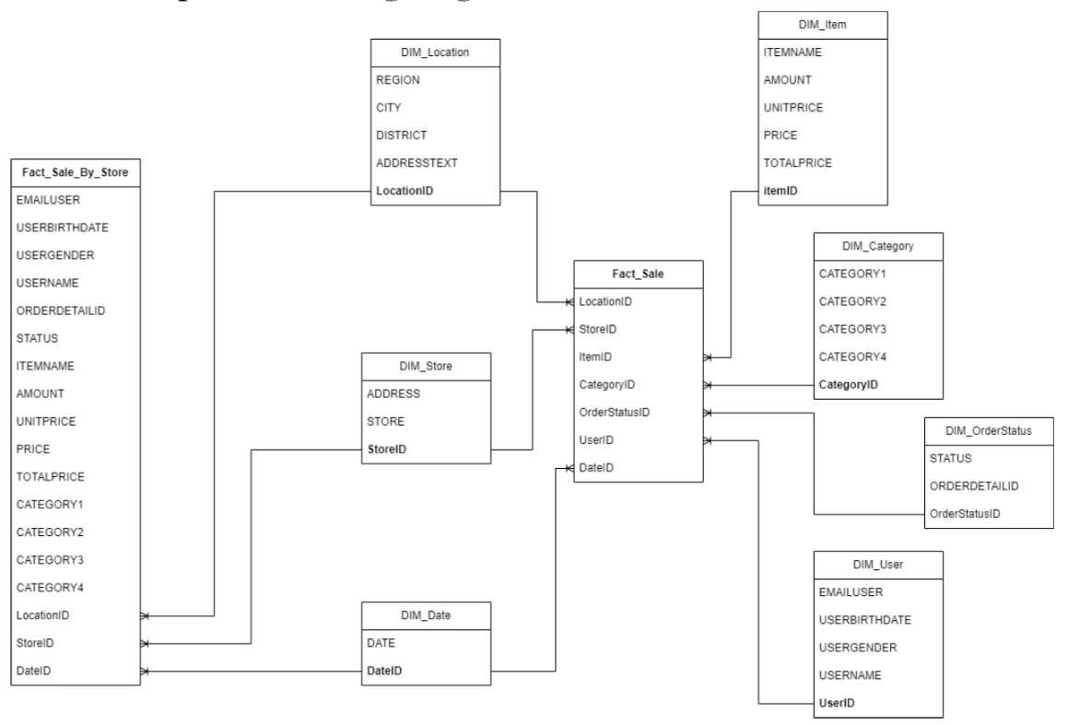
Design Logical
Logical design
Conceptual modeling diagram

Slide 8
2. Data Mining

Slide 9
Some examples of query questions
Question 1: Total daily revenue of the store by status
Question 2: Top 5 Stores with the Highest Sales Volume and Revenue

Slide 10
3.SSIS Process

Slide 11
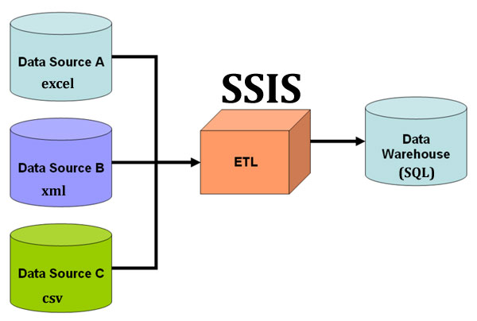

HOW SSIS WORK?
Notes:
SSIS works by providing a development environment to design ETL processes, including control flow, data flow, connections, transformations, and error handling. Once developed, packages can be deployed and executed to perform data integration tasks efficiently.

Slide 12
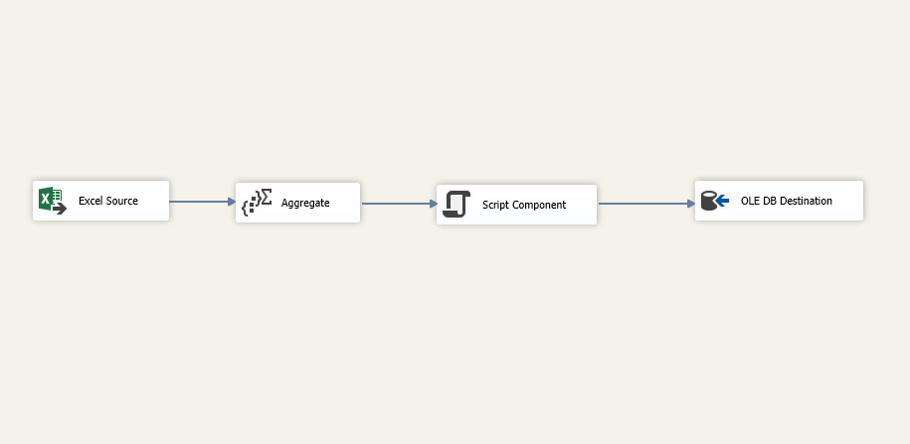
3.SSIS Process
Example
Step 1 : First I Can Import Data Source And add Common Suitable to create Dim or Fact at SQL

Slide 13
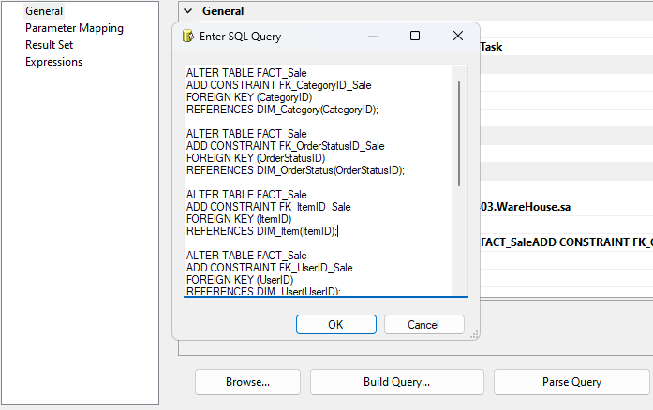
3.SSIS Process
Step 2 : Continue, I can create FK by add Execute SQL Task and add SQL Statement

Slide 14
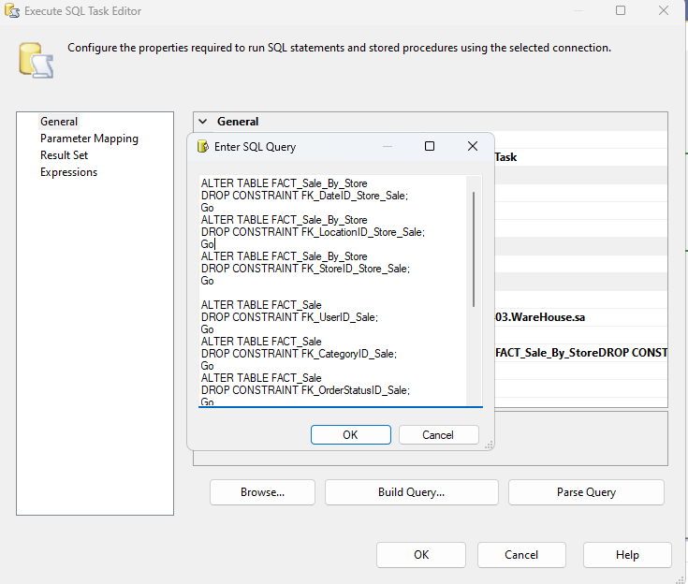
3.SSIS Process
Step 3 : Finally , I’m running direct without truncate ever table, I Delete FK and Delete Data Table direct by create Execute SQL task and add SQL Statement.

Slide 15
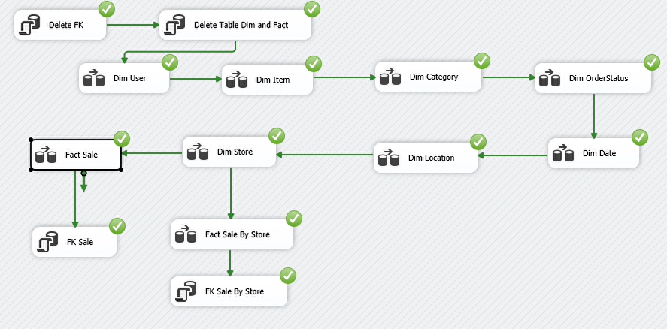
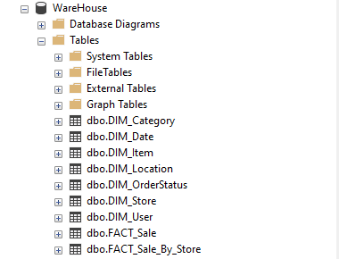
3.SSIS Process
As a result, we can run the full table and create dims and facts in SQL

Slide 16
4.SSAS Process
The process in SSAS involves various operations such as designing cubes, dimensions, and mining models, and then processing them to make them available for querying and analysis.

Slide 17
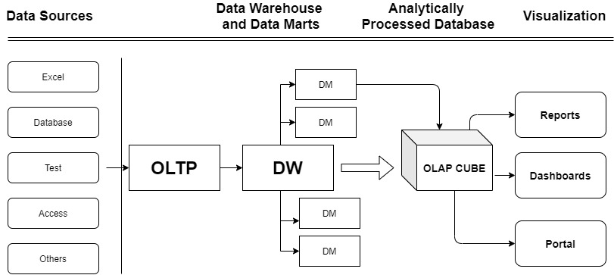
HOW SSAS WORK?
Notes:
SSAS works by connecting to data sources, creating a multidimensional data model, defining cubes, processing data, and providing users with tools to interactively query and analyze data. It plays a crucial role in providing advanced analytics and business intelligence capabilities within the Microsoft SQL Server ecosystem.

Slide 18
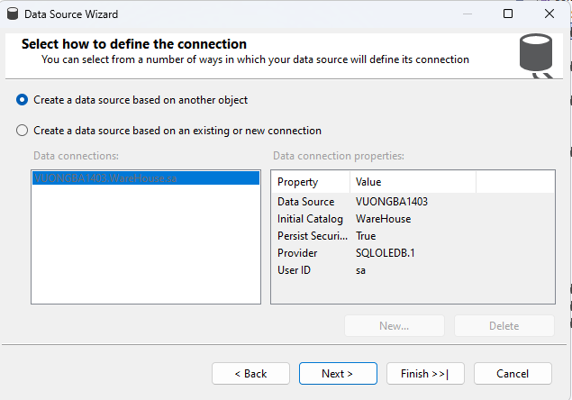
4.SSAS Process
Example
Step 1 : First I Can Import Data Source

Slide 19
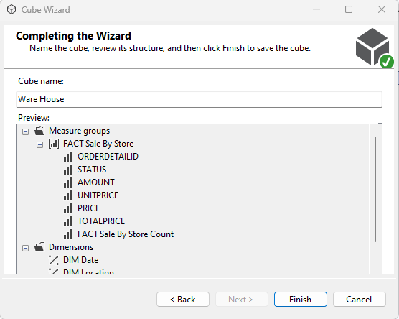
4.SSAS Process
Step 2 : I create cube , add table suitable and next until cube name and finish

Slide 20
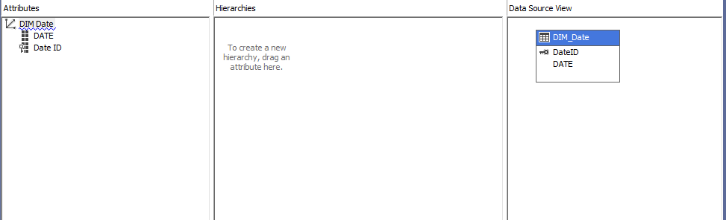
4.SSAS Process
Step 3 : I add attribute suitable to DIM

Slide 21
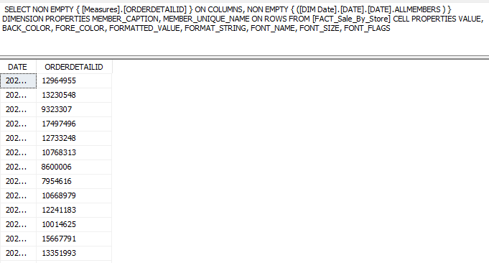
4.SSAS Process
Step 4 : Finally , I build Cube and Process , after i maybe create query in browser Cube of Fact or add query in SQL

Slide 22
5.SSRS Process

Slide 23
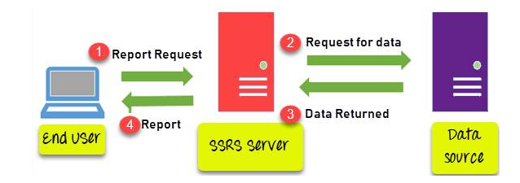
5.SSRS Process
How ssrs works?
Notes:
SSRS works by connecting to data sources, retrieving and processing data, rendering reports based on defined layouts, and making reports available to users through a report server. It provides a comprehensive platform for creating, managing, and delivering a variety of reports in different formats.

Slide 24
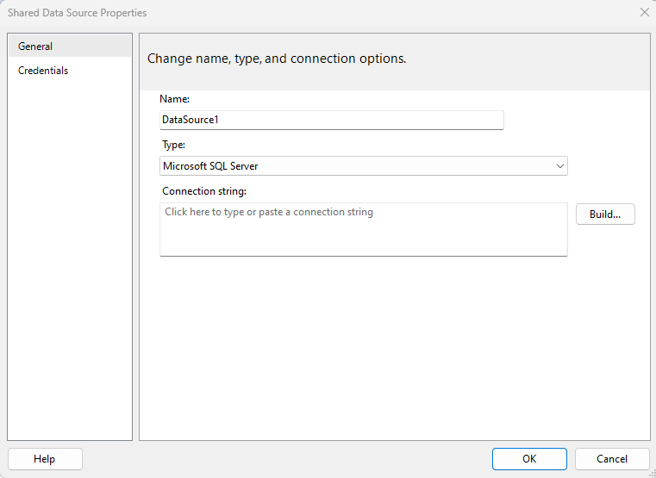
5.SSRS Process
Example
Step 1 : First I Can Import Data Source

Slide 25
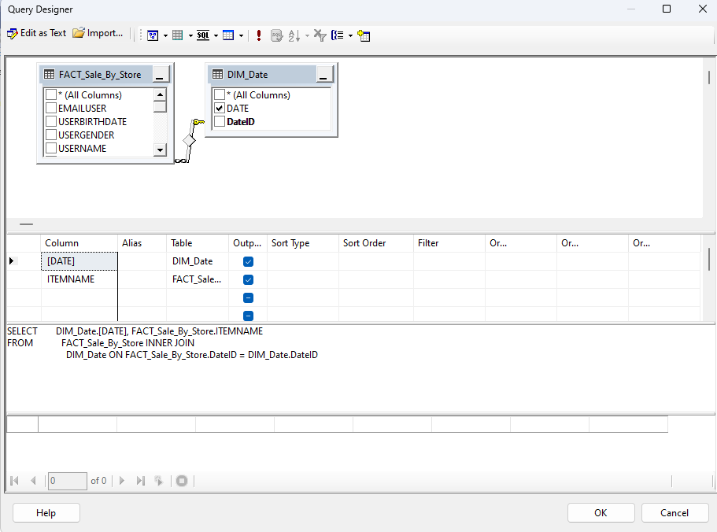
5.SSRS Process
Step 2 :Based on the customer's request, we create a report and add queries that match that request to create a report.
Example : I create Report to number of items sold per day by the store , i add table and choose column suitable

Slide 26
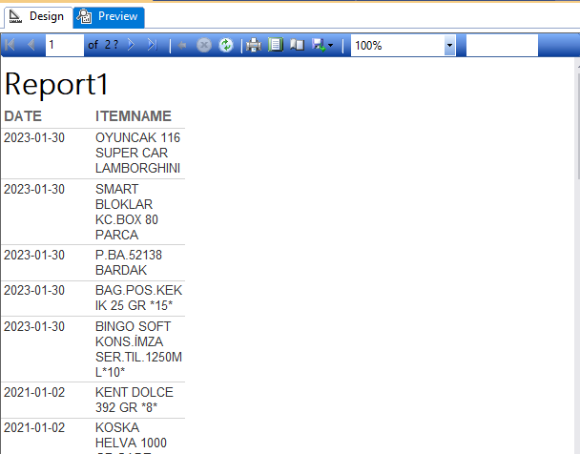
5.SSRS Process
Step 3 : Continue next , add column and choose name table suitable
So, i finish one report

Slide 27
May 2023
THANKYOU
@vku

